Slide 1
Language Component & Loop
By Aksadur Rahman
aksadur@yahoo.com

Slide 2
Agenda
Arithmetic Operations
Operator Precedence
Math Functions
Indentation
If Statements
Logical Operators
Comparison/Relational/Conditional Operators
Assignment Operators
Ternary Operators
While Loops
Break & Continue Statement
Sum of n Numbers Program
For Loops
For-While Comparison
For with Range Function
Nested Loops

Slide 3
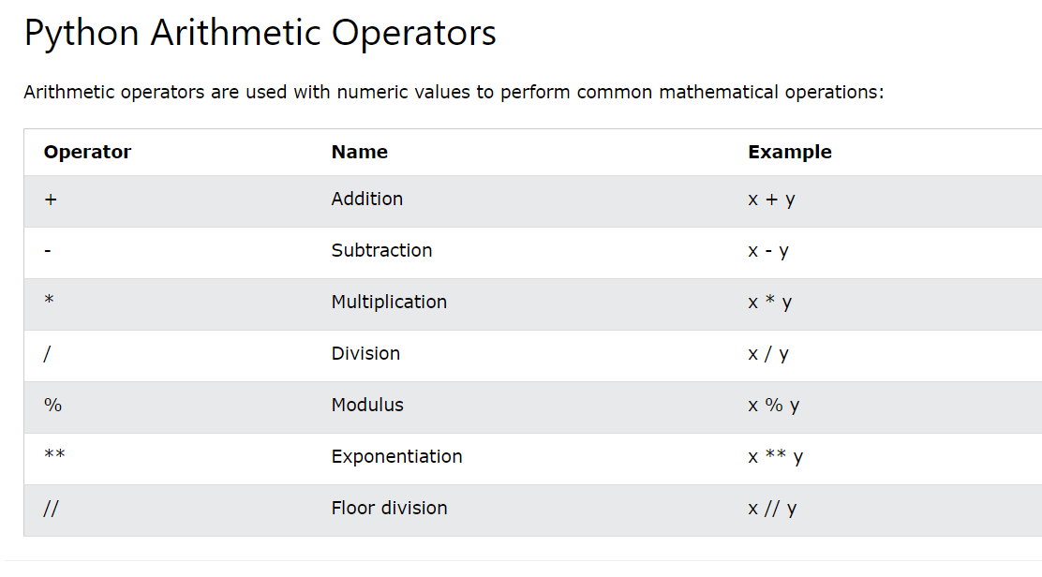
Arithmetic Operations

Slide 4
Arithmetic Operations
Example
val1 = 3
val2 = 2
print(val1 + val2)
print(val1 - val2)
print(val1 * val2)
print(val1 / val2)
print(val1 // val2)
print(val1 % val2)
print(val1 ** val2)

Slide 5
Operator Precedence
Operators | Meaning
() | Parentheses
** | Exponent
*, /, //, % | Multiplication, Division, Floor division, Modulus
+, - | Addition, Subtraction
print(10+3*2**2+45)

Slide 6
Math Functions/Module
Python math Functions
Python Math functions is one of the most used functions in Python Programming. In python there are different built-in math functions. Beside there is also a math module in python.
x=2.9
print(round(x))
print(abs(-2.9))
Python math Module
Python has a built-in module that you can use for mathematical tasks. The math module has a set of methods and constants.
import math
x=2.9
print(math.ceil(x))
print(math.floor(x))
https://www.w3schools.com/python/module_math.asp

Slide 7
Python Indentation
Python Indentation
Indentation refers to the spaces at the beginning of a code line.
if 5 > 2:
print("Five is greater than two!")

Slide 8
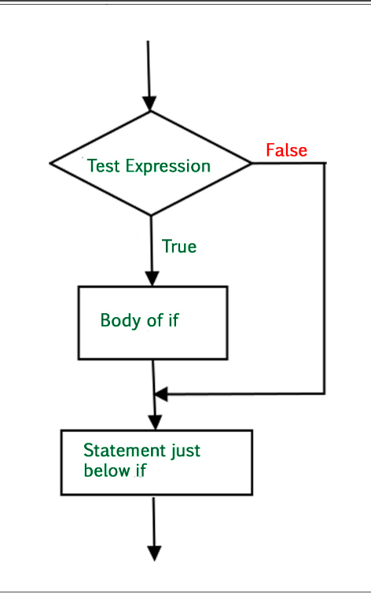
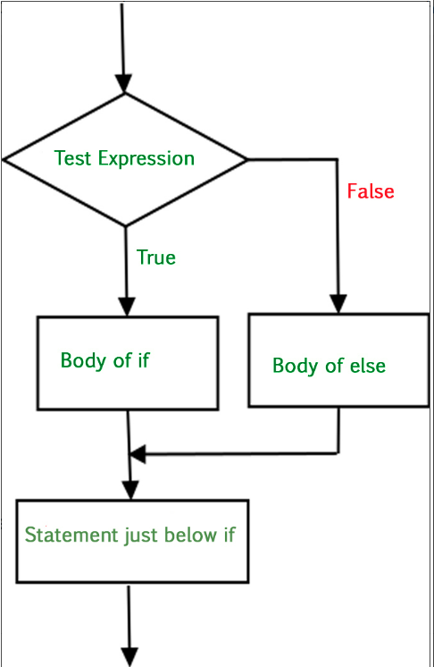
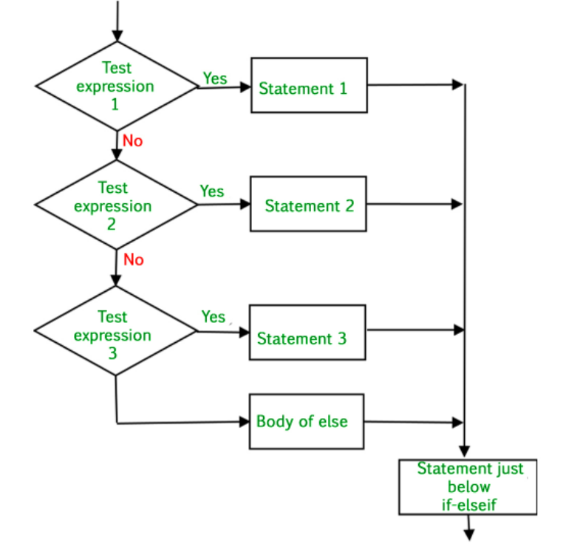
If Statements
if statement
if statement is the most simple decision-making statement. It is used to decide whether a certain statement or block of statements will be executed or not i.e if a certain condition is true then a block of statement is executed otherwise not.
if
If……else
If……elif……else

Slide 9
If Statements
Example
if
If……else
If……elif……else
i = 10
if i > 15:
print("10 is less than 15")
print("I am Not in if")
i = 20
if i < 15:
print("i is smaller than 15")
print("i'm in if Block")
else:
print("i is greater than 15")
print("i'm in else Block")
print("i'm not in if and not in else Block")
i = 20
if i == 10:
print("i is 10")
elif i == 15:
print("i is 15")
elif i == 20:
print("i is 20")
else:
print("i is not present")

Slide 10
Match Case
Example
num = 3
match num:
# pattern 1
case 1:
print("One")
# pattern 2
case 2:
print("Two")
# pattern 3
case 3:
print("Three")
# default pattern
case _:
print("Number not between 1 and 3")

Slide 11
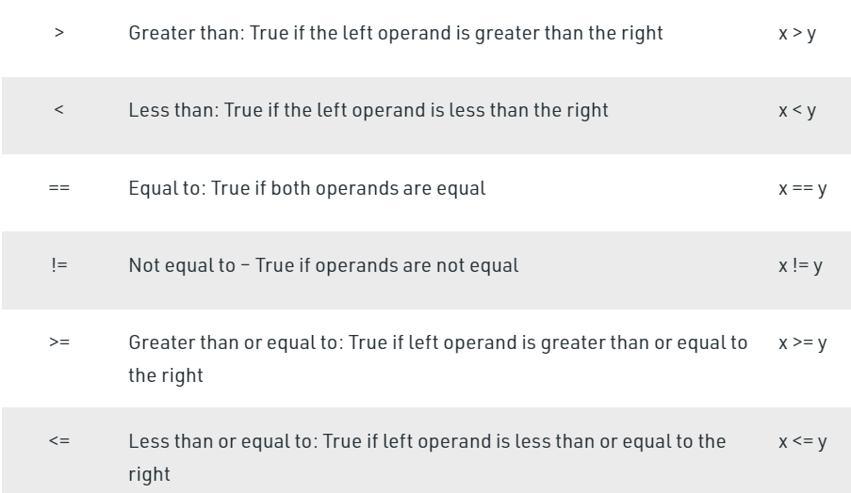
Comparison/Relational/Conditional Operators

Slide 12
Comparison/Relational/Conditional Operators
Example:
a = 9
b = 5
print(a > b)
print(a < b)
print(a == b)
print(a != b)
print(a >= b)
print(a <= b)

Slide 13
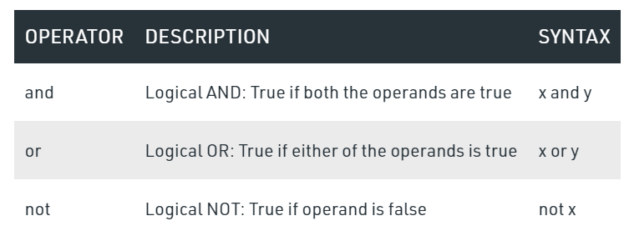
Logical Operators
and
a = 10
b = 10
c = -10
if a > 0 and b > 0:
print("The numbers are greater than 0")
if a > 0 and b > 0 and c > 0:
print("The numbers are greater than 0")
else:
print("Atleast one number is not greater than 0")

Slide 14
Logical Operators
or
not
a = 10
b = -10
c = 0
if a > 0 or b > 0:
print("Either of the number is greater than 0")
else:
print("No number is greater than 0")
if b > 0 or c > 0:
print("Either of the number is greater than 0")
else:
print("No number is greater than 0")
a = 10
if not (a%3 == 0 or a%5 == 0):
print("10 is not divisible by either 3 or 5")
else:
print("10 is divisible by either 3 or 5")

Slide 15
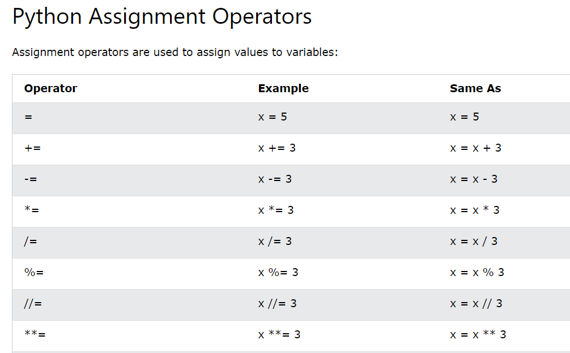
Assignment Operators

Slide 16
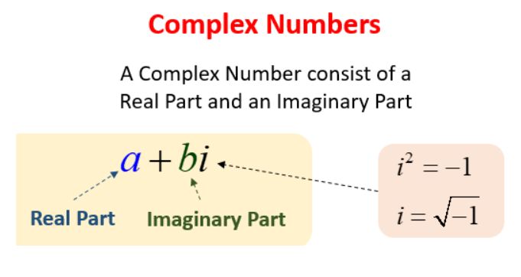
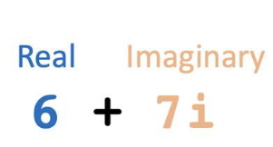
Numeric Data Types
Python Number Types: int, float, complex
Complex
A complex number is a number with real and imaginary components. For example, 5 + 6j is a complex number where 5 is the real component and 6 multiplied by j is an imaginary component.
Complex data types is used while developing scientific applications where complex mathematical operation is required.
a=6+7j
print(a)
print(a.real)
print(a.imag)
print(type(a))
b=5+5j
print(a+b)

Slide 17
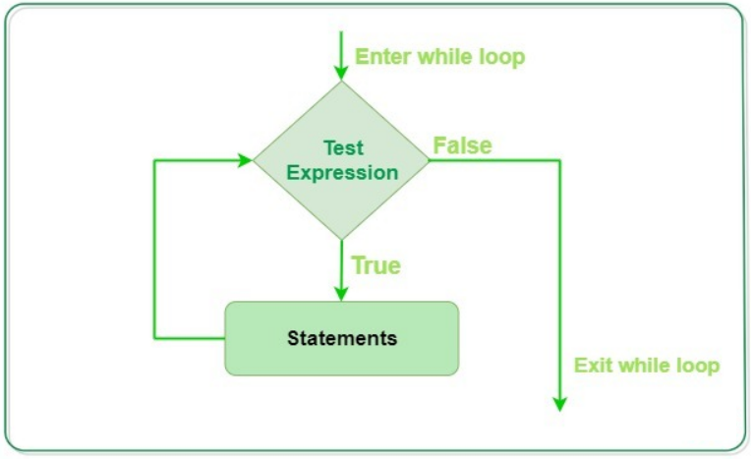
While Loops
A while loop statement in Python programming language repeatedly executes a target statement as long as a given condition is true.
count = 0
while count < 9:
print('The count is:', count)
count = count + 1
print("Good bye!")

Slide 18
Sum of n Numbers Program
n = int(input("Enter the n Number:"))
sum = 0
i = 1
while i <= n:
sum = sum + i
i = i +1
print(sum)

Slide 19
Break & Continue Statement
Break
Continue
i = 1
while i < 6:
print(i)
if i == 3:
break
i += 1
i = 0
while i < 6:
i += 1
if i == 3:
continue
print(i)

Slide 20
sum = 0
while True:
num = input("Enter a Number: ")
if num == "quit":
break
try:
num = int(num)
except:
print("Enter a valid number please.")
continue
sum = sum + num
print(sum)

Slide 21
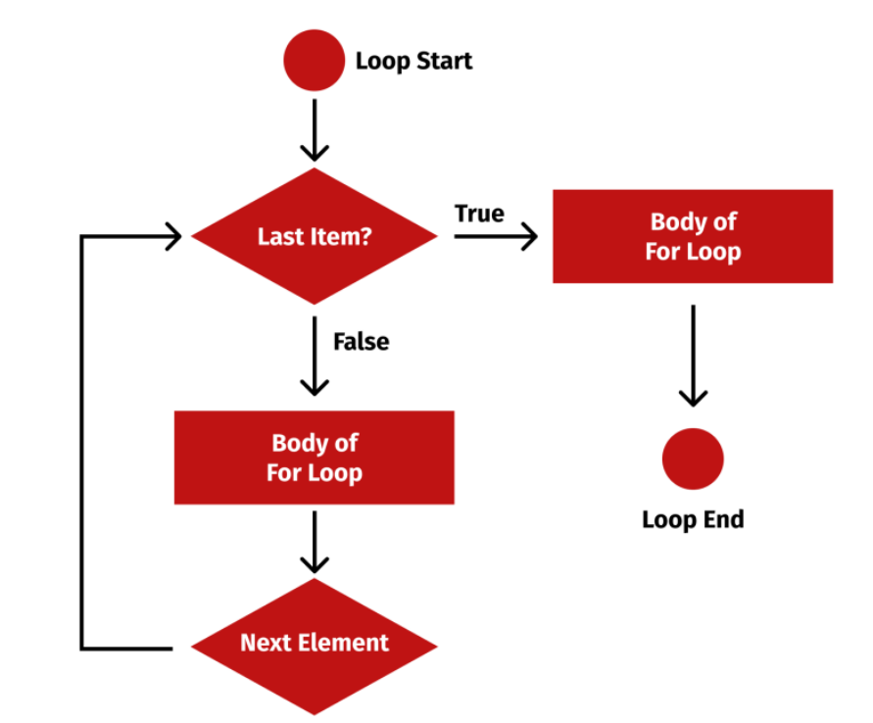
For Loops
For Loops
A for loop is used for iterating over a sequence (that is either a list, a tuple, a dictionary, a set, or a string).

Slide 22
For Loops
#Looping Through a String
for x in "banana":
print(x)
#Looping Through a list
fruits = ["apple", "banana", "cherry"]
for x in fruits:
print(x)
#The break Statement
#Exit the loop when x is "banana"
fruits = ["apple", "banana", "cherry"]
for x in fruits:
print(x)
if x == "banana":
break
#The continue Statement
#Do not print banana:
fruits = ["apple", "banana", "cherry"]
for x in fruits:
if x == "banana":
continue
print(x)

Slide 23
For-While Comparison
while
for
num = [10, 20, 30, 40, 50]
index = 0
n = len(num)
while index < n:
print(num[index])
index = index+1
num = [10, 20, 30, 40, 50]
for x in num:
print(x)

Slide 24
For with Range Function
The range() Function
To loop through a set of code a specified number of times, we can use the range() function,
#Using the range() function:
for x in range(6):
print(x)
#Using the start parameter:
for x in range(2, 6):
print(x)
#Increment the sequence with 3 (default is 1):
for x in range(2, 30, 3):
print(x)

Slide 25
For with Enumerate
num = [30, 10, 70, 12]
for i, x in enumerate(num):
print(i, x)

Slide 26
Nested Loops
adj = ["red", "big", "tasty"]
fruits = ["apple", "banana", "cherry"]
for x in adj:
for y in fruits:
print(x, y)

